Slide 1
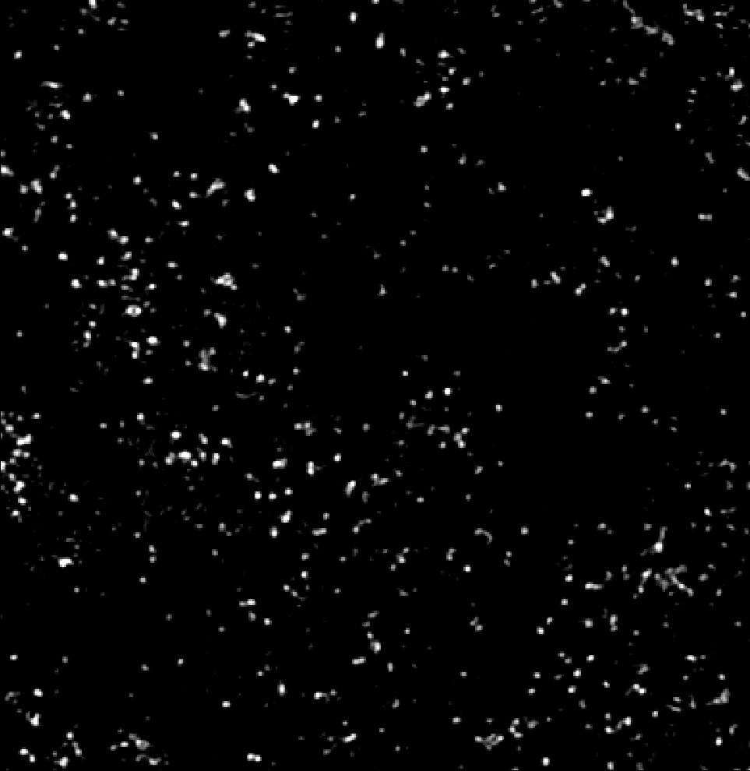
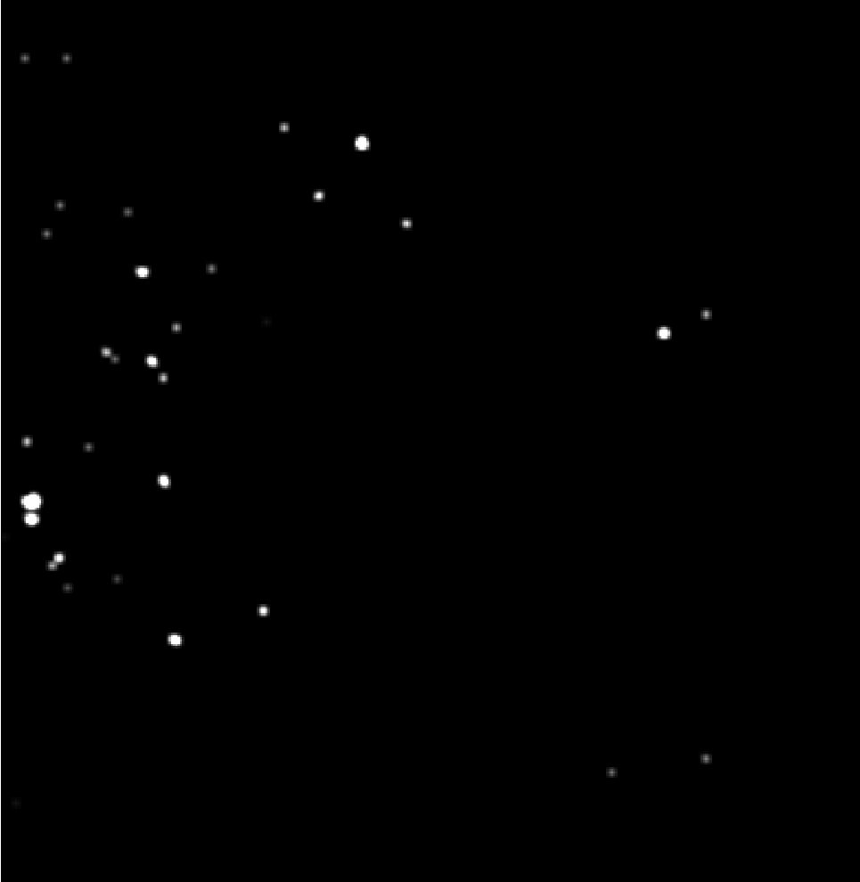
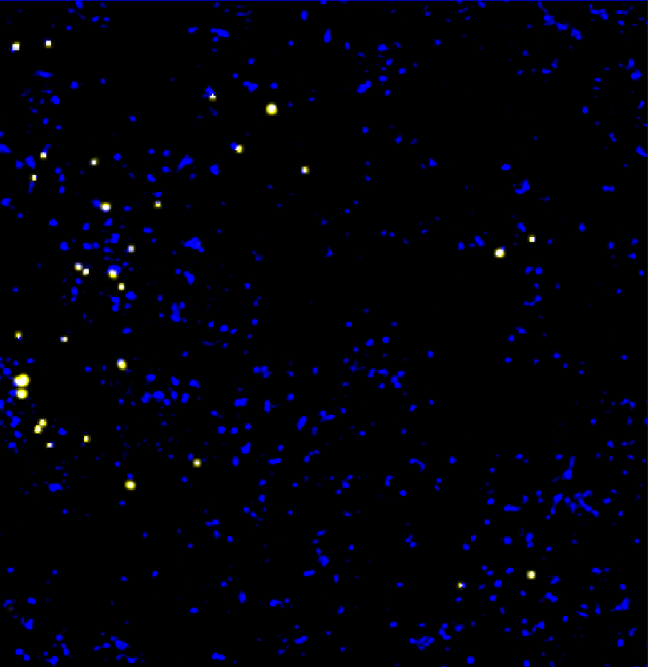
PANORAMA H460 (5%) and NHBE (95%) Mixture
PANORAMA
Time: 45 min wash
Count: 1029
Fluorescence (397 ± 67)
Time: 45 min wash
Count: 30
Overlayed
Blue: PANORAMA
Yellow: PANORAMA and fluorescence
2.9 % of detected exosomes show mir-21 (2.9%/5%= 58 %)
Scale bar: 10 µm

Slide 2
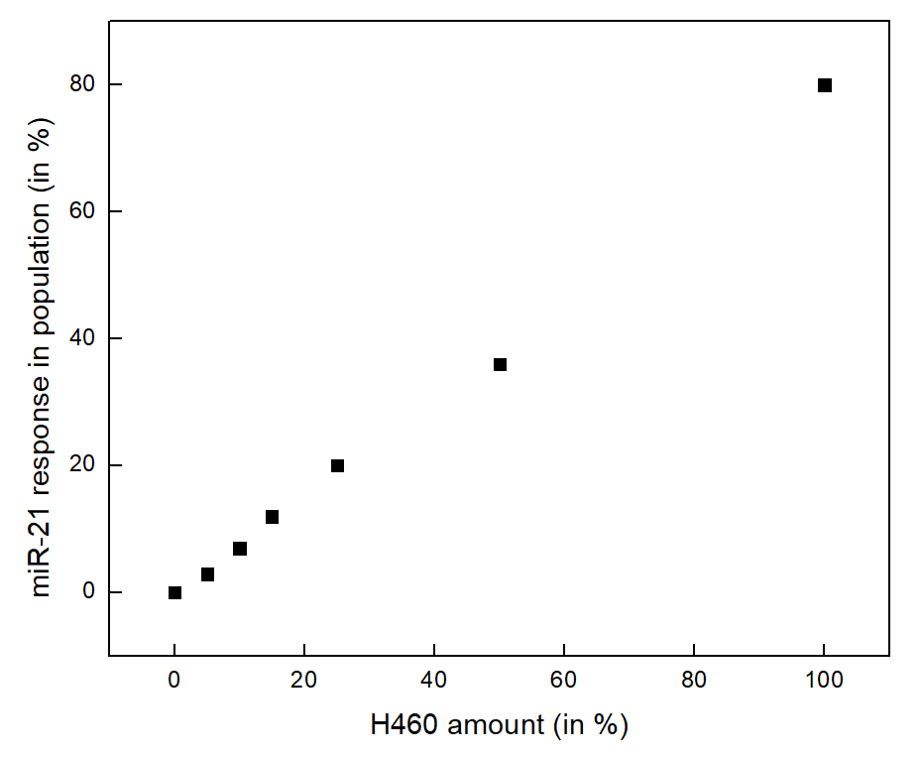
Summary miR-21 response with different mixtures of NHBE and H460 exosomes
Future work on molecular beacon
Find the detection limit of the system.
1 % H460

Slide 3
Experimental Details
Received samples: HCR 55 (Healthy) and 825A (cancer)
Plasma (10 microliter) was diluted 4 times for both cases.
Concentration: unknown.
Size Distribution: Unknown.
Experimental duration: 30 min.
Antibody used: none.

Slide 4

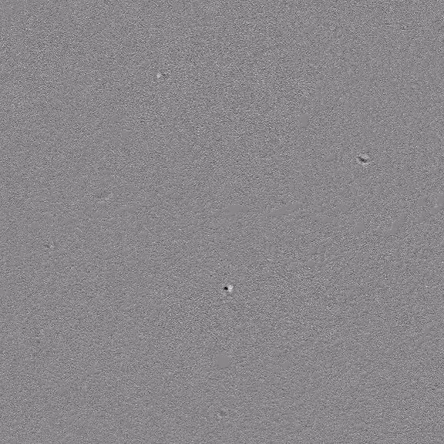
Monitoring Plasma HCR 55 normal via PANORAMA within a single video
Time: 10 min
Time: 15 min
Few particles detected with size range 1 to 3.5 µm
Video duration: 12 sec
Scale bar: 10 µm

Slide 5
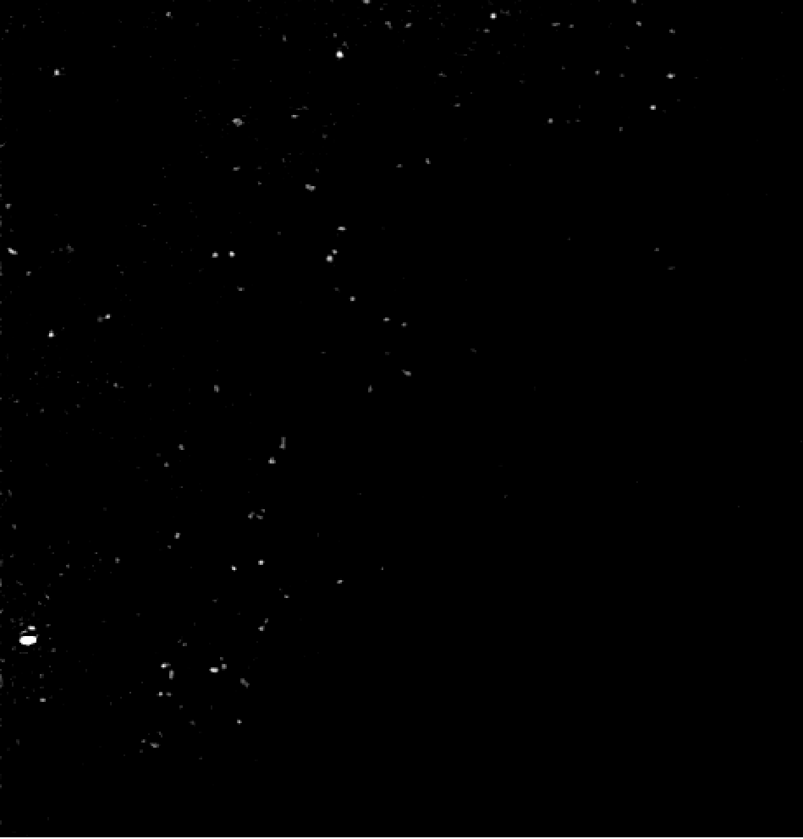
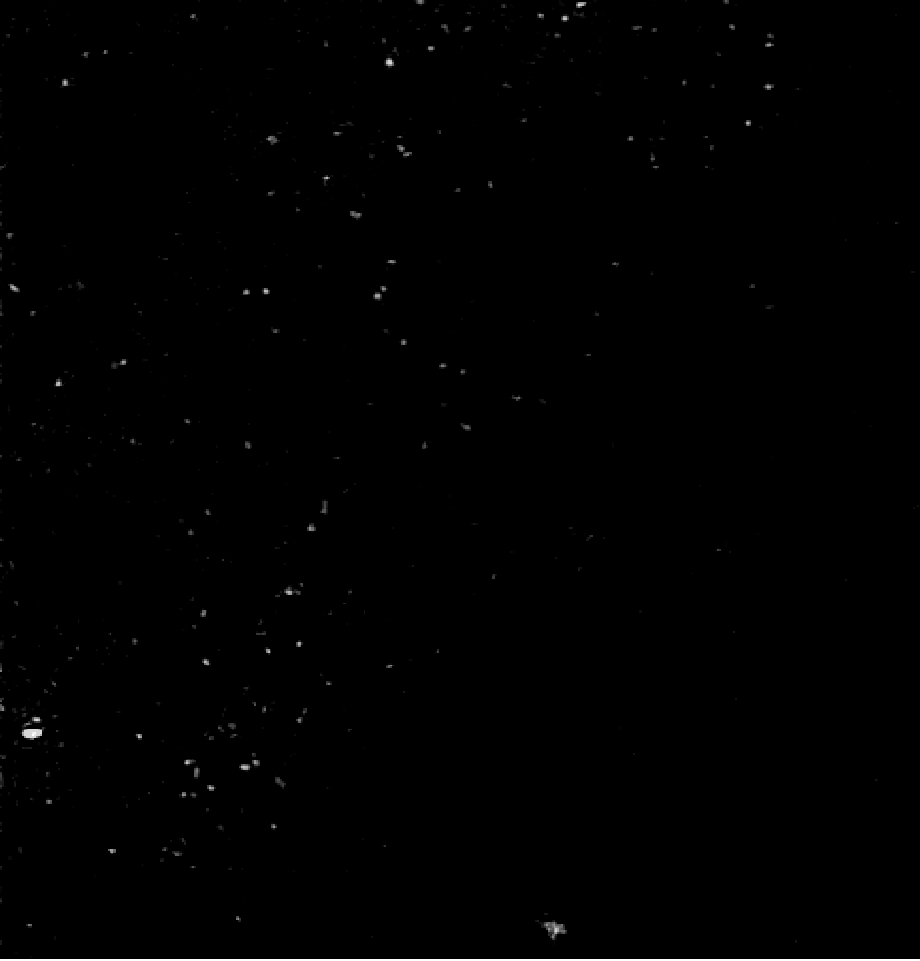
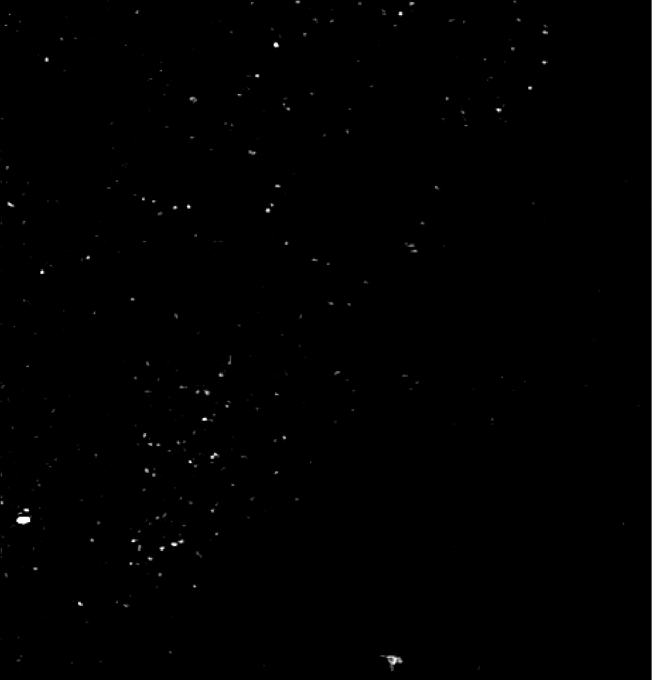
Particle settlement in time with plasma HCR 55
PANORAMA
Time: 5 min
Count: 152
PANORAMA
Time: 10 min
Count: 203
PANORAMA
Time: 20 min
Count: 368
Scale bar: 10 µm

